Slide 1

MUzix
Team Members-
Aman Jain
Nitin Sanjay Patil
Robinpreet kaur
Ahmad Asadud Darain

Slide 2
INTRODUCTION
Muzix app is platform where you can browse through the tune from all over the world.
People from all walks of life can listen to music.

Slide 3
Project Overview
Login
Favorite
Authentication
API
Favorite
API
Home
Register
Recommendations
API
Recommendations
Search
SQL
Server
Mongo
Db
Mongo
Db
External
API

Slide 4
Project Overflow
Home
Login
Register
Search
Add to favorite
Favorite
Recommendation
View Favorite
Delete Favorite
View Recommends
Add to Favorite

Slide 5
Model
Register
Register & Login
Search by
artist/album
Search
country-wise
Save
Save favorites
Recommend
Recommend songs

Slide 6
Model
Register
Register & login
We used JWT token service to authorize user.
Search by
Search by album & artist
User can search for artist/album and is provided with relevant searches.
Search
Search country-wise
Music from all over world is presented for user.
Save
Save favorites
User can save his playlist and play it later
Recommend
Recommend songs
The most recommended song can be seen along with number of recommendations.
This feature is made available to registered users.

Slide 7

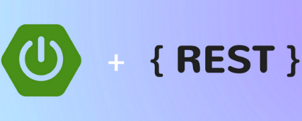
Technologies Used
Angular – Used Angular 14.0.0 for developing
single page application.
Spring – Made use of REST API services of
spring boot.

Slide 8


MySQL – Used MySQL 8.0.29 database for
storing user registration specific details.
MongoDB – used mongoDB 5.0.9 for storing
user’s favorite and recommendations.
Microservices – At the end we merged with microservices.

Slide 9
Microservices
Authentication API
Favorite API
Recommendation API

Slide 10
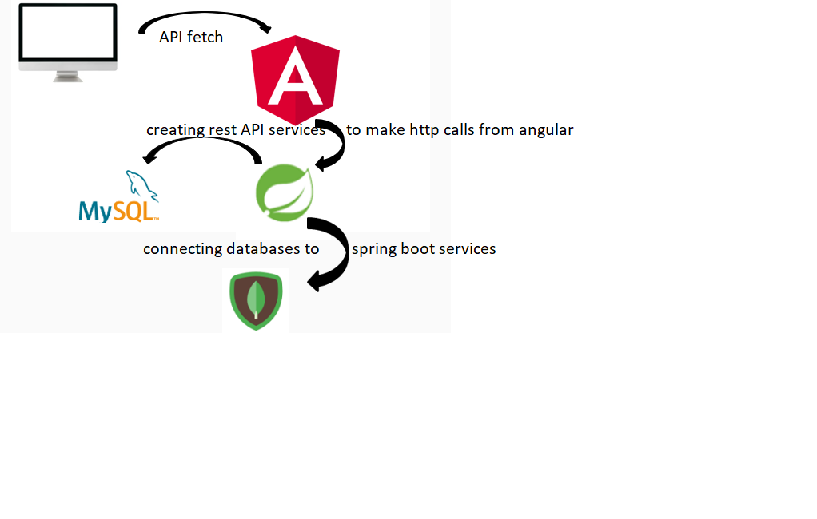
Project Design

Slide 11
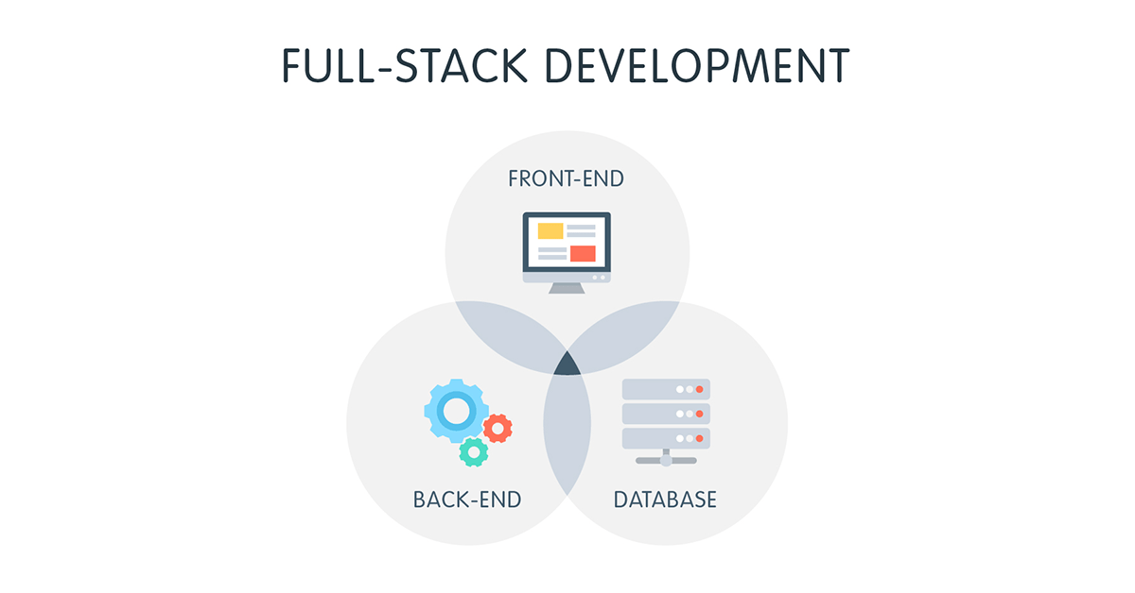
Conclusion

Slide 12
Thank You

